Slide 1
INVESTMENT ANALYSIS OF THREE PROMINENT ARTIFICIAL COMPANIES (Google, Meta and Open AI) By Rachael Oluwakemi Agunloko Job Title: Data Analyst

Slide 2
EXECUTIVE SUMMARY
The summary of results generated by the comprehensive data analysis at : are
Google has the highest revenue from 2015 -2024, then Meta and lastly Open AI
Google has the highest investment on artificial intelligence followed by Meta and Open AI consecutively.
Open AI has the highest compound annual growth rate (CGAR), then Meta and Lastly Google.
Google spent most on stock, then Meta and Open AI

Slide 3
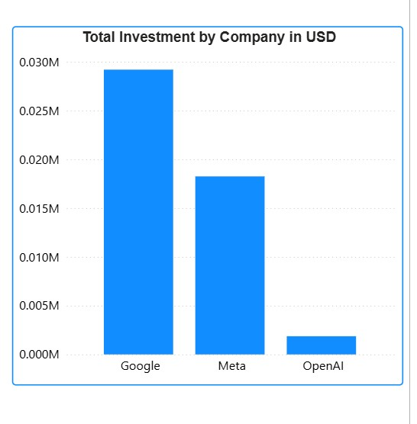
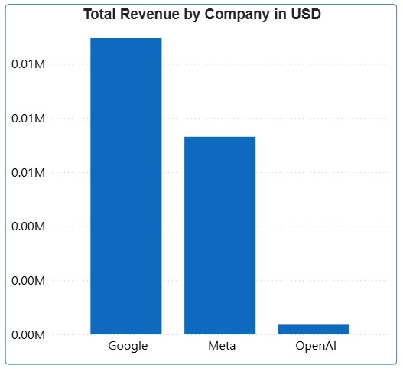
Investment and Revenue Analysis
Google and Meta have higher revenue and investment capacity because of extensive advertisement, decades of infrastructure, user bases, and cash flow.
OpenAI is playing a different game. It is a high-growth, high-risk pure AI bet. It has grown revenue extremely fast from a tiny base.

Slide 4
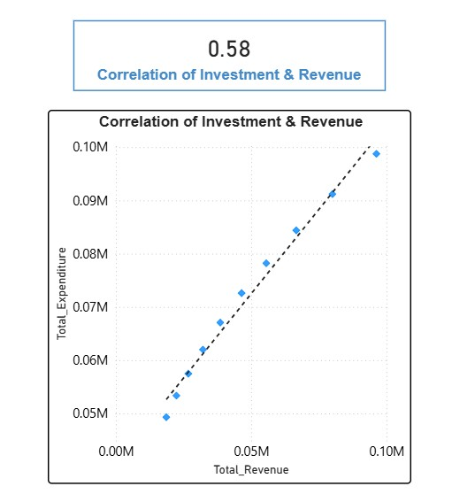
Correlation Analysis
The correlation relationship between cumulative investment and cumulative revenue is positive. Revenue increases as investment increases but less than 50%. It suggests investment is important but innovation, execution and marketing time matters too.

Slide 5
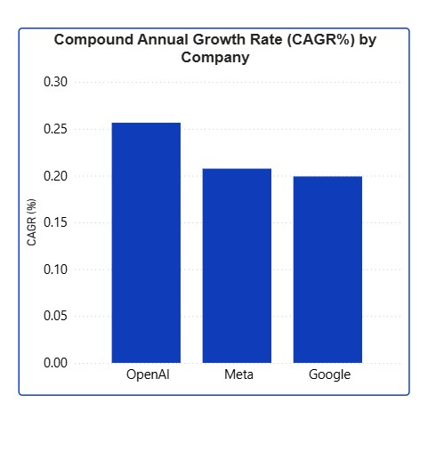
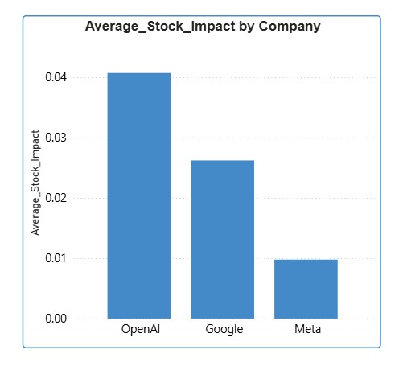
Compound Annual Growth Rate
OpenAI has extremely high revenue of ~ 200%+ annual income from 2023 because it thrives on the generative A.I wave, low base, new market and productive business model. It also spent least on stocks.

Slide 6
Recommendations
AI companies should implement remote and hybrid work models for their employees as it reduces amount spent of physical structures.
A.I companies should tailor their innovations to specific aspects of human daily activities.
Implementing user-subscription models

